Slide 1

Disaster Tweet Classification
Bharti Jagyasi

Slide 2
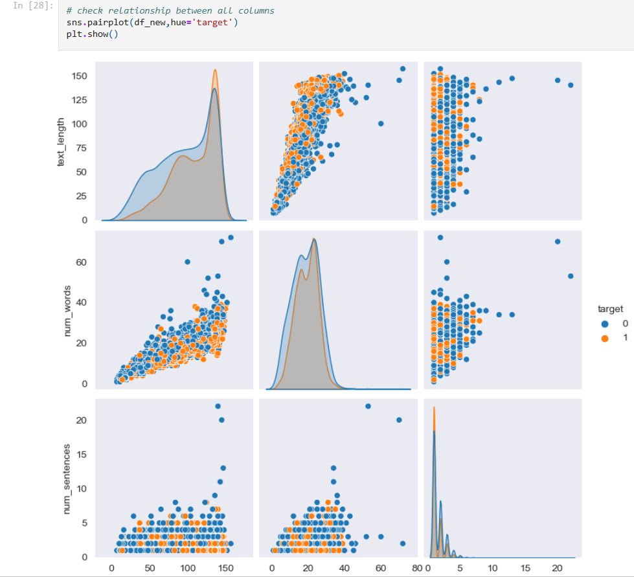
Data Preparation, Feature Engineering and Visualization

Slide 3
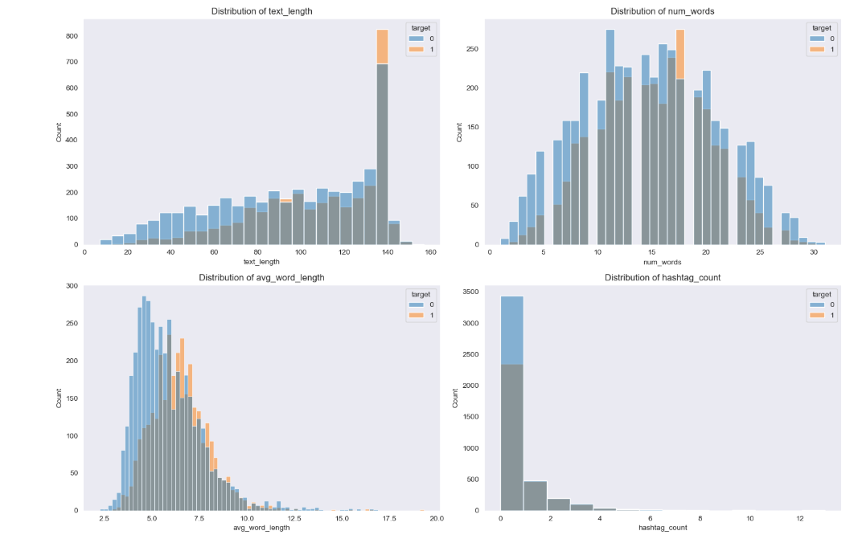
Data Preparation, Feature Engineering and Visualization

Slide 4
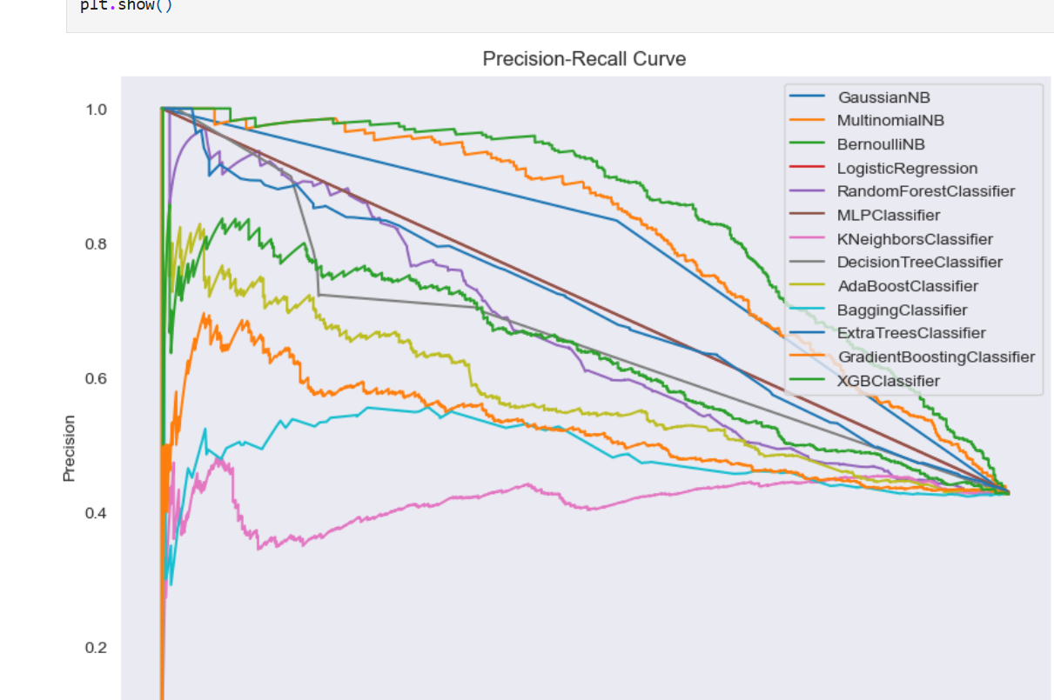
Model Evaluation

Slide 5
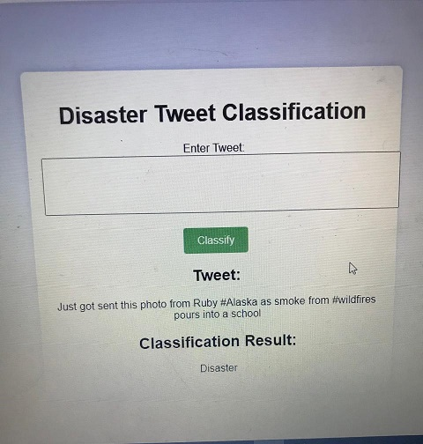
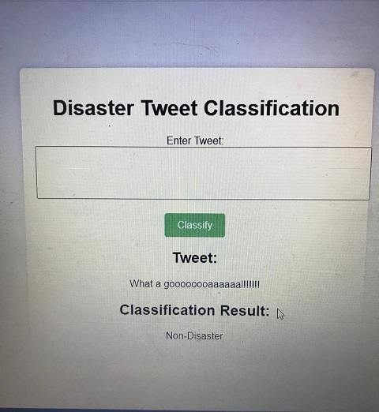
Prediction

Slide 6
Thank You

